Slide 1
Credit Union Connect Tennessee Credit Union League Hot Topics in Commercial Lending
October 12, 2023

Slide 2
Agenda
IBS Overview
Why Aren’t You Making Commercial Loans
Regulatory Environment
Risks To Loan Growth/Quality
Impact on Lending / Portfolio
Board Responsibility
Comments & Questions

Slide 3
Services Offered
Consulting
Commercial Lending Start Up
Market Evaluation
Hiring
Loan Policy
Credit Training
Sales Training
Board Training (Regs)
Participation Sales
Commercial Loan Underwriting
Loan Document Generation
Appraisal and Environmental Management
Loan Servicing
Shared Lender Program

Slide 4
IBS History
Formed 2008 & started operations in 2009 in Fort Mill, SC
Wholly owned by 7 credit unions in the Carolinas
Through 2013 had underwritten $150 million in MBL
At YE 2013 was servicing $40 million portfolio
Since 2014 have underwritten over 3000 loans totaling over $2.3 billion
Credit union portfolios have grown from $40 million to over $820 million in that period
Underwrote 422 loans totaling $333 million in 2020
Underwrote 342 loans totaling $323 million in 2021
Underwrote 344 loans totaling $423 million in 2022
At 12-31-22 over $820 million in portfolio underwritten by IBS
99.6% rated Satisfactory or better
Of over 1800 loans only 3 not rated Satisfactory or better
Past dues range typically under .10%.
No net charge off on a loan underwritten by IBS

Slide 5
Why Aren’t You Making Commercial Loans?
Too Risky
Nope. But it is MESSY!!
Don’t have knowledge/expertise/cooperative core
That’s what CUSOs are for
Commercial Lenders are hard to find & too expensive
Yes, they are. They are also divas, but there are workarounds to all those issues.
Now is just not the right time
Why?
Lack of liquidity
Thanks, FED. Can be fixed but is a challenge
Recession is coming
Is it? So what if it is. That is not the time to stop lending or to not start lending
Core won’t support business loan or deposits
Can be fixed

Slide 6
Here’s What You are Missing
Growth and diversification of membership
For every new business member, you have a captive audience for several new consumer memberships and ability to cross sell consumer products
Growth and diversification of revenue stream
For every $10 million in outstanding loans, potential for $350,000+ in net interest income
Growth and diversification of a consumer heavy loan portfolio that is more susceptible to economic changes
Higher margin on loans
Large loan fees
Commercial deposits

Slide 7
Regulatory Environment
Reg change took effect 1-1-2017
Exams now focusing on regs v. loan policy

Slide 8
Principles Based Regulation
Purpose is to give credit unions more flexibility to implement principle-based risk management processes and policies and staff to maintain a comprehensive understanding of the borrower’s financial capacity.
Credit unions must establish risk tolerances at the relationship and overall portfolio levels to ensure that the risks taken are consistent with prudent standards within the managerial and financial capability of the credit union.

Slide 9
Principle Based Regs
Message that examinations will be made based on the law and not on philosophical intent
MBLs redefined
Loans secured by 1-4 family residential real estate
Loans secured by vehicles manufactured for household use
MBLs don’t count toward cap
The cap is the lesser of 1.75 times the actual net worth or 1.75 times the minimum net worth per the risked based standards.

Slide 10
The New Commercial Loan Policy
Must address:
Types of commercial loans permitted
Trade Area
Portfolio concentration limits
Single borrower limits
Qualifications and experience requirements for lending staff
Loan approval process
Underwriting standards
Risk Management processes
Annual Reviews, collateral inspections and revalued

Slide 11
NCUA Expectations
Underwriting analysis depth and content.
Due diligence and risk evaluation requirements of principals of business borrowers.
Financial projection analysis when historical results insufficient.
No longer need to use industry ratios for real estate financing.
Financial statement quality and verification expectations.
Collateral perfection and valuation requirements, including LTVs appropriate for specific collateral type.

Slide 12
Revising the MBL Policy Risk Management Process
Use of loan covenants
Frequency of financial reporting
Frequency and depth of ongoing loan review and collateral value monitoring
A credit risk rating system, at inception, and through life of loan; tracking migration of risk grades
A process to track and report policy exceptions and loan covenants

Slide 13
Post Reg Change NCUA Findings
Lack of Board oversight & involvement relative to new rules
Inadequate staffing & resources for oversight of 3rd parties
Lack of ongoing credit administration of the portfolio
ARs, Management reports, Risk Grade migration
Inadequate or delinquent ARs
Lack of risk assessment & staffing relative to commercial lending & how it fits into the credit union’s business or strategic plan
Lack of personal guarantees with lack of evidence of risk mitigation

Slide 14
Post 2017 Reg Changes
Appraisal Regs
Set commercial loan threshold to $1 million
Contrary to all other regulators that went to $500,000
CUSO Regs
Established CUSOs can make any loans that CUs make
Gave NCUA ability additional flexibility to approve permissible CUSO activities and services outside of notice and comment.
CECL

Slide 15
Post 2017 Reg Changes
Proposed Financial Innovation: Loan participations, eligible obligations, and notes of liquidating credit unions
Major impact on 701.21-Loans and lines of credit to members
Little to no effect on 701.22
701.23 establishes notes purchased from liquidating FCUs
Eligible obligations defined as anything that is not being sold as a participation
Widens ability to purchase non member loans
Ability to purchase whole or in part
Helps with FinTech and other 3rd party originators
Mostly impacting consumer loans
Indirect loans/leases
Loans made by third parties
Dealerships, CUSOS, etc.

Slide 16
Post 2017 Reg Changes
5% cap remains on participation purchases but does not apply to purchases of eligible obligations
Definition of indirect loan and lease comes from guidance that has been in use
701.23 addresses Eligible Obligations
Comment period ends 2-28-23
Expected to be approved by NCUA board between June and August 2023.

Slide 17
NCUA 2023 Supervisory Priorities
Interest Rate & Liquidity Risk
Letter to CU 22-CU-09
Market Risk
Stress Test on loans & portfolio
Key assumptions are reasonable and documented
Liquidity
Related to IRR volatility
Higher rates impacting asset valuation & borrowing capacity

Slide 18
NCUA 2023 Supervisory Priorities
Credit Risk
CU’s credit risk review system in identifying, monitoring and managing credit risk
Evaluate how credit risk is changing due to inflation, borrowing costs from higher rates & increased likelihood of economic downturn
Review adjustments made to underwriting standards, portfolio monitoring practices and to loan loss reserves
Current expected credit loss from CECL implementation
Fraud Prevention & Detection

Slide 19
Recent NCUA Letters and Policy Statements
Climate Change Financial Risk for Credit Unions
Physical Risk
Affecting the industry
Strategies to prepare for effects of physical risk
Impact on Members
Financially vulnerable populations
Steps needed to continue lending to these populations
Transition Risk
Risks affecting operations, RE lending, commercial lending and small business lending
Steps to minimize transition risk
Steps to mitigate transition risk

Slide 20
Recent NCUA Letters and Policy Statements
Climate Change Financial Risk for Credit Unions
Operations
Governance
Business Strategies
Risk Management
Looking for a Climate Policy
Identify, measure, monitor, manage, and report climate related financial risks
Impact on traditional risk areas: credit, interest rate, liquidity, transition, strategic, reputation, and compliance
Risk mitigation strategies
Flood risk
Reporting

Slide 21
Recent NCUA Letters and Policy Statements
Policy Statement on Prudent CRE Loan Accommodations and Workouts
“FIs that implement prudent CRE loan accommodation and workout arrangements after performing a comprehensive review of the borrower’s financial condition will not be subject to criticism for engaging in these efforts, even if these arrangements result in modified loans with weaknesses that result in adverse classification”

Slide 22
Recent NCUA Letters and Policy Statements
Policy Statement on Prudent CRE Loan Accommodations and Workouts
“Modified loans to borrowers who have the ability to repay their debts according to reasonable terms will not be subject to adverse classification solely because the value of the underlying collateral has declined to an amount less that is less than the outstanding balance on the loan”

Slide 23
Recent NCUA Letters and Policy Statements
Policy Statement on Prudent CRE Loan Accommodations and Workouts
Short-Term Loan Accommodations
Accounting Changes
CECL
Valuation Adjustments
Market Conditions Classification
Global Cash Flow
Frequency of Updated Financial and Collateral Information
Proactive Engagement with Borrowers

Slide 24
Recent NCUA Letters and Policy Statements
Policy Statement on Prudent CRE Loan Accommodations and Workouts
Loan Workout Programs
Renewing or Extending Loans
Granting additional credit to improve prospects of overall payment
Restructuring the loan with or without concessions
Updated and comprehensive financial info on borrower, property and guarantors
Current valuations of the collateral
Appropriate loan structure (term, amortization, covenants, other requirements
Appropriate legal analysis and agreements
Global cash flow/debt coverage analysis

Slide 25
Recent NCUA Letters and Policy Statements
Policy Statement on Prudent CRE Loan Accommodations and Workouts
Loan Workout Policy that establishes
Loan terms/amortization to reasonably adjust the workout plan is sustained performance is not demonstrated
Management infrastructure to identify, measure, and monitor the volume and complexity of the workout activity
Documentation standards to verify borrower’s credit worthiness: financial condition, repayment ability, coll values
Information systems and controls to identify and track loan performance and risk
Processes to ensure regulatory reports are consistent with regulatory requirements
Loan collection procedures
Adherence to lending limits
Collateral administration
Ongoing credit risk review function

Slide 26
It’s The Economy, Stupid!!
No, It’s the Pandemic!!!
No, It’s the Economy Again!!!
No, It’s the Stupid FED

Slide 27
No, It’s the Pandemic/Economy
Nationwide shut down
Extended in some markets
Huge impact on small businesses, home renters/landlords, and certain CRE products (retail, multi family, office, hospitality)
Dire predictions for commercial RE
Supply Chain problems still occurring
2021 Retail Sales rose 21.4% above its pre-pandemic Feb 2020 peak

Slide 28
No, It’s the Economy, again
Job quit rates in 2020 and 2021 were unprecedented while unemployment rebounded from the effects of the shutdowns and lay offs
Businesses still can’t fill open positions
Inflation increasing since start of pandemic and was over 6% in 2021, hit a high of 9.1% in Jun ’22, declining since then to 7.7% in Oct. Now 12 straight months of decline.

Slide 29
No, It’s the stupid FED
Fed fund target rate remained low; 0%-.25%, but a rising rate environment was expected with 3-4 .25% bumps in 2022 sand into 2023.
Reality is there have been 11 increases since March 2022 raising Fed rate from .25-.50% to 5.25-5.50% thru July ‘23. Another 25 bps expected in before YE (?)
Devastating impact on FI liquidity
Erosion of capital
FI failures

Slide 30
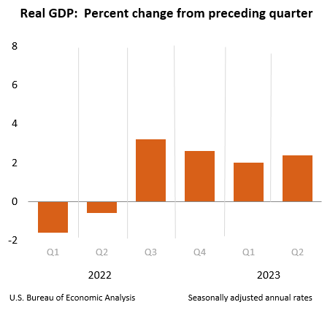
How Are We Doing Now

Slide 31
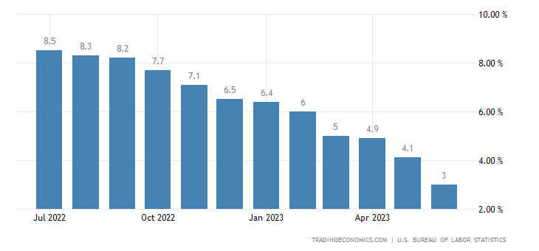
How Are We Doing Now

Slide 32
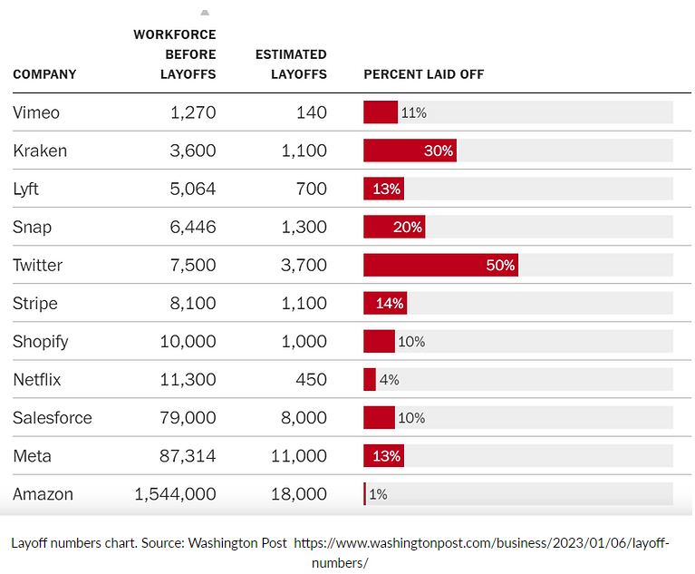
Headlines & Headwinds

Slide 33
Headlines & Headwinds
As of March 31, 2023, over 170 companies have conducted a total of 55,790 layoffs
10.1 million vacant jobs in April 2023
Yellow Trucking gone. 30,000 jobs lost
Hiring numbers have been declining
Divided country/government
Trade Policy/Trade War
Recession? For the last 18 months it’s been 6 months away
Overheated job market ?
Businesses still can’t find workers

Slide 34
Headlines & Headwinds
Irrational Exuberance/Equity markets
Tech, tech, and tech.
Oh yeah, and everything else.
Growing budget deficits/debt
Debt ceiling debate will continue
US credit downgraded
Global inflation and interest rate increases
Sources: Wells Fargo Securities Economic Group, Regions Financial Corp. Economic Group,
Wall Street Journal

Slide 35
Headlines & Headwinds
Liquidity Issues
Households have burned through pandemic savings
Investors still have lots of cash-just not in the FIs
Inability to house business deposits
No commercial loan program in your credit union

Slide 36
So, What Does All This Mean for Commercial Lending?
Underwriting
Peel the onion all the way to the core
Get all the information up front
You know what credit needs and what they will ask for
Ask questions and get answers
Follow proper due diligence practices
Trust (?) but verify
Loan policy is your bible. Use it like one.
Dot the I(s) and cross the T(s). Then do it again.
Remember you are the one fronting the $$ needed for the project

Slide 37
So, What Does this Mean for Commercial Lending?
Portfolio Management
Review portfolio now
Annual Reviews
Yes, they are meaningful if done right.
Don’t use it as a check mark on a list.
Do you have fully executed docs in file?
Are collateral docs in order and liens perfected and protected?
Recorded UCCs, recorded mortgages and AOR? Liens on titles?
Current insurance with CU as loss payee.
Have RE taxes been paid, or was collateral sold in a tax sale and you still don’t know?
Have you inspected the collateral?
Take your attorney to lunch

Slide 38
So, What Does this Mean for Commercial Lending?
Above all else, do not stop lending
Modify appetite for risk
Be more selective about deals
Get the rate and fees associated with the risk
But stay active in the commercial lending arena

Slide 39
Contact Information
Mark Cox
President & CEO
P O Box 956
Irmo, SC 29063
Phone: 803-881-2500
mcox@ibscu.com
www.ibscu.com

